Slide 1

HTML 5
UNIT - II

Slide 2
HTML 5
HTML 5 is the fifth and current version of HTML. It has improved the markup available for documents and has introduced application programming interfaces (API) and Document Object Model (DOM).
Features:
It has introduced new multimedia features which supports both audio and video controls by using <audio> and <video> tags.
There are new graphics elements including vector graphics and tags.
Enrich semantic content by including <header> <footer>, <article>, <section> and <figure> are added.
Drag and Drop- The user can grab an object and drag it further dropping it to a new location.
Geo-location services- It helps to locate the geographical location of a client.

Slide 3
Web storage facility which provides web application methods to store data on the web browser.
Uses SQL database to store data offline.
Allows drawing various shapes like triangle, rectangle, circle, etc.
Capable of handling incorrect syntax.
Easy DOCTYPE declaration i.e., <!doctype html>

Slide 4
New Elements in HTML 5
<article>: The <article> tag is used to represent an article. More specifically, the content within the <article> tag is independent from the other content of the site (even though it can be related).
<aside>: The <aside> tag is used to describe the main object of the web page in a shorter way like a highlighter. The <aside> tag contains mainly author information, links, related content and so on.
<figcaption>: The <figcaption> tag in HTML is used to set a caption to the figure element in a document.
<figure>: The <figure> tag in HTML is used to add self-contained content like diagrams, photos or codes listing in a document.
<header>: It contains the section heading as well as other content, such as a navigation links, table of contents, etc.

Slide 5
<footer>: The <footer> tag in HTML is used to define a footer of HTML document. This section contains the footer information (author information, copyright information, carriers etc.). The footer tag is used within body tag. The <footer> tag is new in the HTML 5. The footer elements require a start tag as well as an end tag.
<main>: Delineates the main content of the body of a document or web app.
<mark>: The <mark> tag in HTML is used to define the marked text. It is used to highlight the part of the text in the paragraph.
<nav>: The <nav> tag is used to declaring the navigational section in HTML documents. Websites typically have sections dedicated to navigational links, which enables user to navigate the site. These links can be placed inside a nav tag.
https://www.geeksforgeeks.org/html5-introduction/

Slide 6
Canvas
The HTML 5 <canvas> tag is used to draw graphics using scripting language like JavaScript.
The <canvas> element is only a container for graphics, you must need a scripting language to draw the graphics.
There are several methods in canvas to draw paths, boxes, circles, text etc.
How to create a HTML canvas?
A canvas is a rectangle like area on an HTML page. It is specified with canvas element. By default, the <canvas> element has no border and no content, it is like a container.
Syntax:-
<canvas id = "mycanvas" width ="200" height ="100"> </canvas>
Note: Always specify an id attribute (to be referred to in a script), and a width and height attribute to define the size of the canvas. To add a border, use the style attribute.

Slide 7
To create a Rectangle in Canvas
<html>
<head>
<title>Canvas Tutorial</title>
</head>
<body>
<h1>Canvas Tutorial</h1>
<canvas id="mycanvas" height="400px" width="500px" style="border: 1px solid green;"></canvas>
<script>
var canvas=document.getElementById("mycanvas");
var ctx=canvas.getContext("2d");
ctx.fillStyle="green";
ctx.fillRect(80,120,500,500);
</script>
</body>
</html>

Slide 8
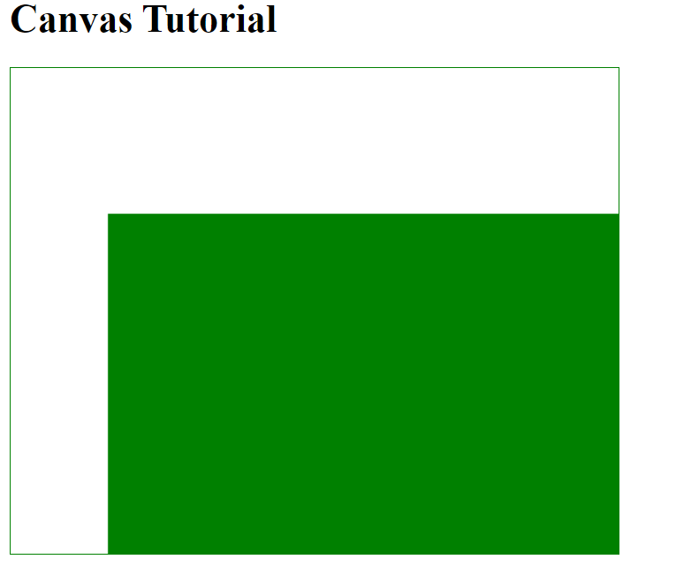

Slide 9
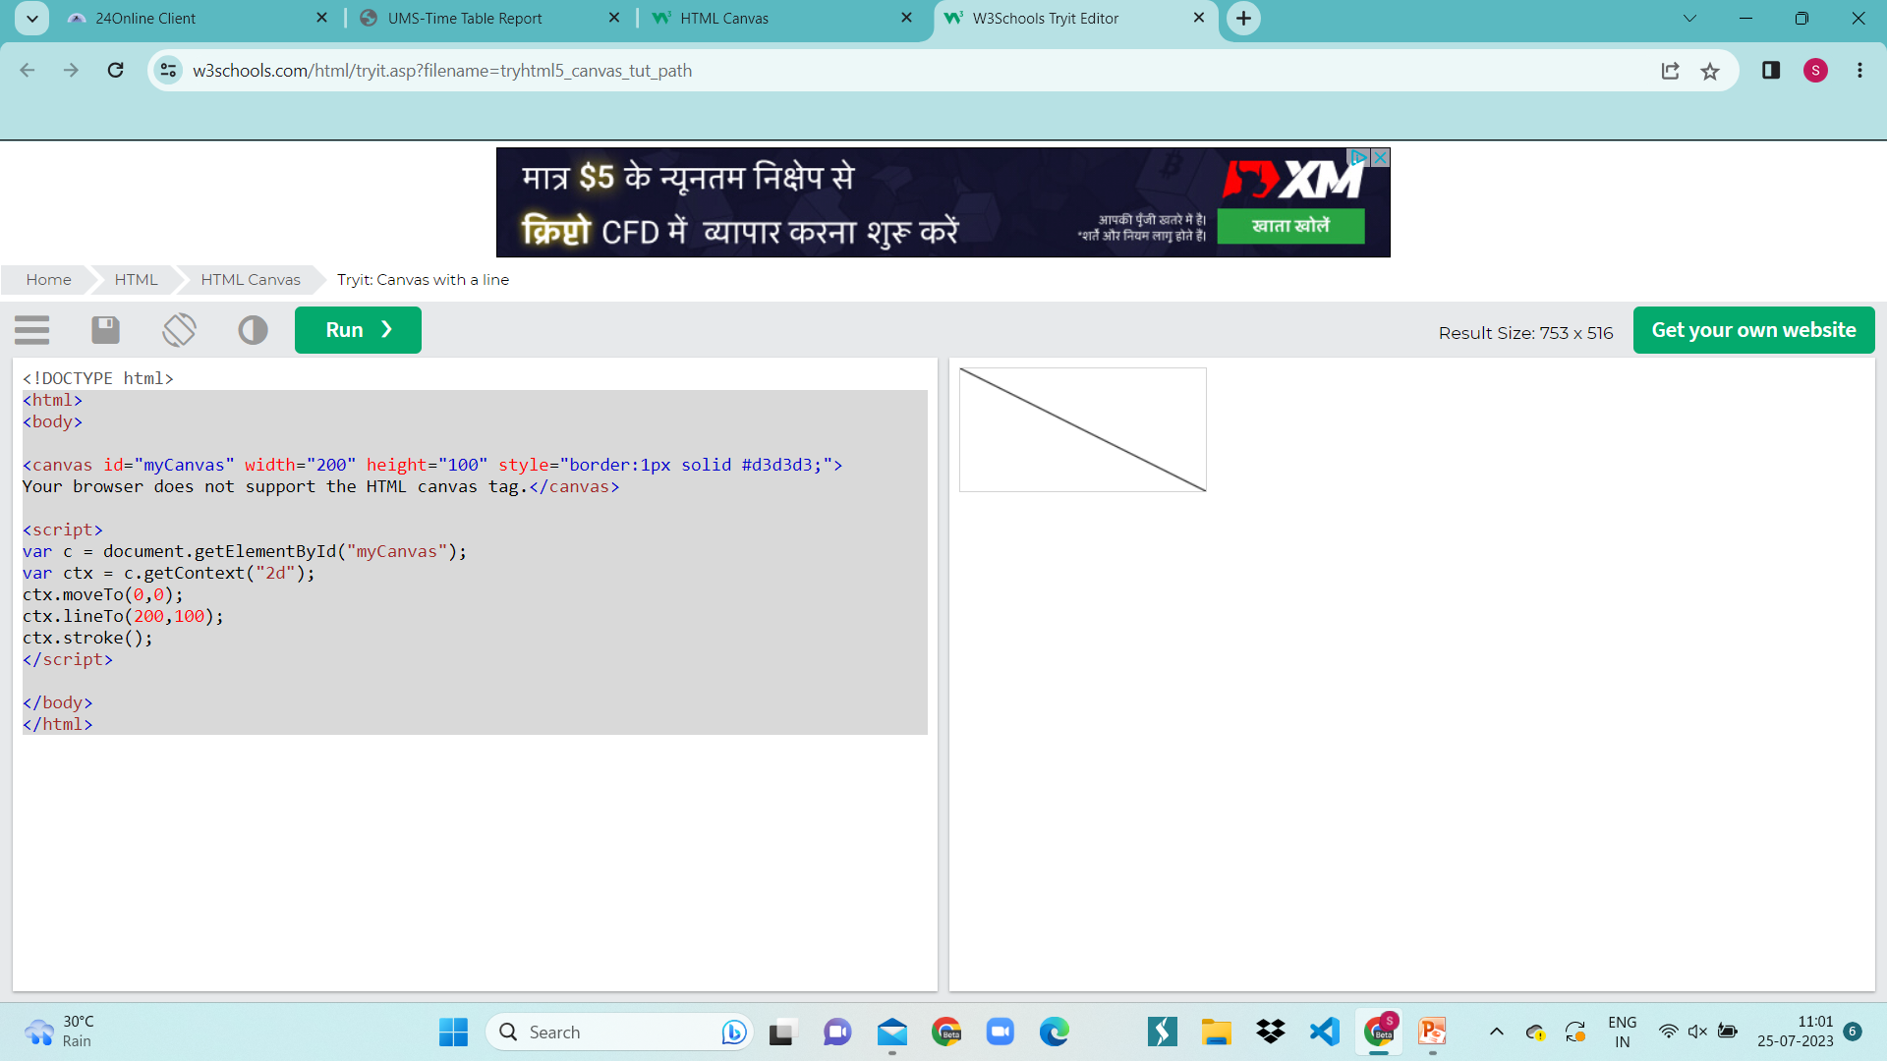
To Draw a line in Canvas
After creating the rectangular canvas area, you must add a JavaScript to do the drawing.
<html>
<body>
<canvas id="myCanvas" width="200" height="100" style="border:1px solid #d3d3d3;">
Your browser does not support the HTML canvas tag.</canvas>
<script>
var c = document.getElementById("myCanvas");
var ctx = c.getContext("2d");
ctx.moveTo(0,0);
ctx.lineTo(200,100);
ctx.stroke();
</script>
</body>
</html>
output

Slide 10
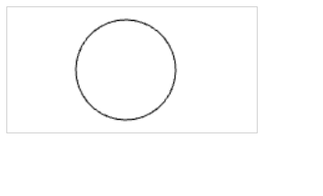
To draw a circle using canvas
<!DOCTYPE html>
<html>
<body>
<canvas id="myCanvas" width="200" height="100" style="border:1px solid #d3d3d3;">
Your browser does not support the HTML canvas tag.</canvas>
<script>
var c = document.getElementById("myCanvas");
var ctx = c.getContext("2d");
ctx.beginPath();
ctx.arc(95,50,40,0,2*Math.PI);
ctx.stroke();
</script>
</body>
</html>

Slide 11
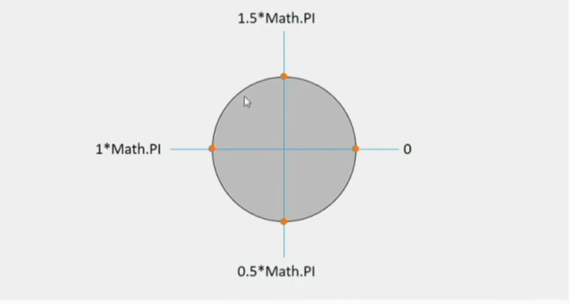

Slide 12
IMAGE
<!DOCTYPE html>
<html>
<body>
<p>Image to use:</p>
<img id="scream" src="img_the_scream.jpg" alt="The Scream" width="220" height="277">
<p>Canvas to fill:</p>
<canvas id="myCanvas" width="250" height="300"
style="border:1px solid #d3d3d3;">
Your browser does not support the HTML canvas tag.</canvas>
<p><button onclick="myCanvas()">Try it</button></p>
<script>
function myCanvas() {
var c = document.getElementById("myCanvas");
var ctx = c.getContext("2d");
var img = document.getElementById("scream");
ctx.drawImage(img,10,10);
}
</script>

Slide 13
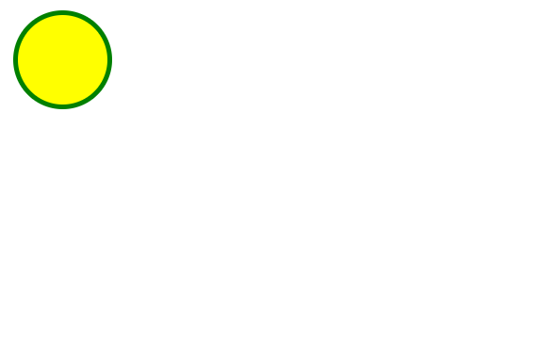
SVG
SVG defines vector-based graphics in XML format.
SVG stands for Scalable Vector Graphics
SVG is used to define graphics for the Web
The HTML <svg> element is a container for SVG graphics.
SVG has several methods for drawing paths, boxes, circles, text, and graphic images.
<svg width="100" height="100"> <circle cx="50" cy="50" r="40" stroke="green" stroke-width="4" fill="yellow" /> </svg>

Slide 14
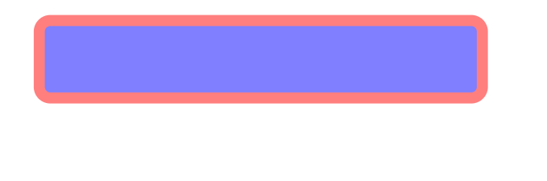
SVG Rectangle
<!DOCTYPE html>
<html>
<body>
<svg width="500" height="200">
<rect x="50" y="20" width="400" height="70" fill="blue" stroke="red" stroke-width="10" rx="10" opacity="0.5" />
</svg>
</body>
</html>

Slide 15
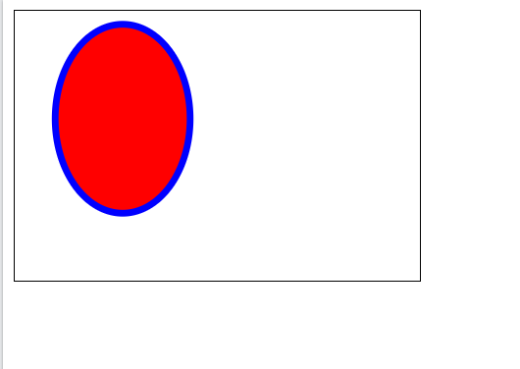
SVG Ellipse
<!DOCTYPE html>
<html>
<body>
<svg width="300" height="200" style="border:1px solid black">
<ellipse cx="80" cy="80" rx="50" ry="70" fill="red" stroke="blue" stroke-width="5" />
</svg>
</body>
</html>

Slide 16
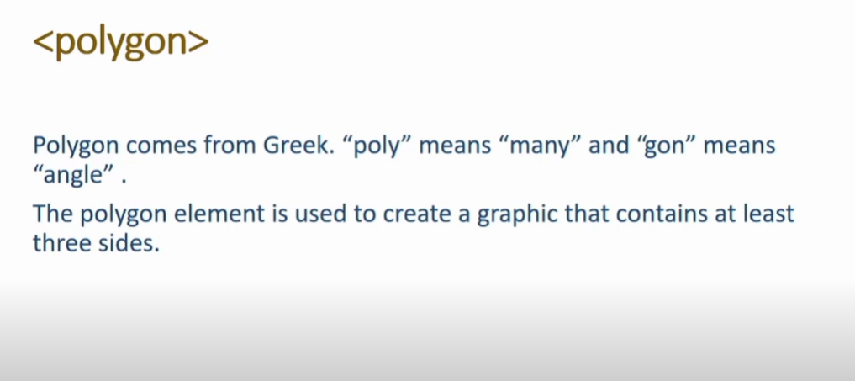
SVG Polygon

Slide 17
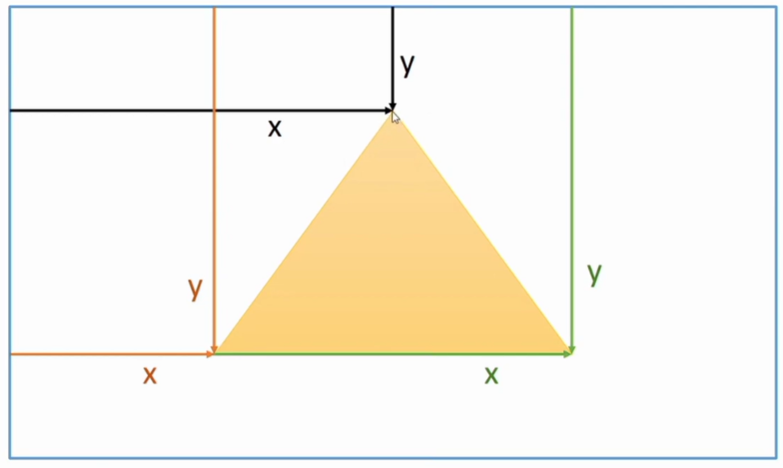

Slide 18
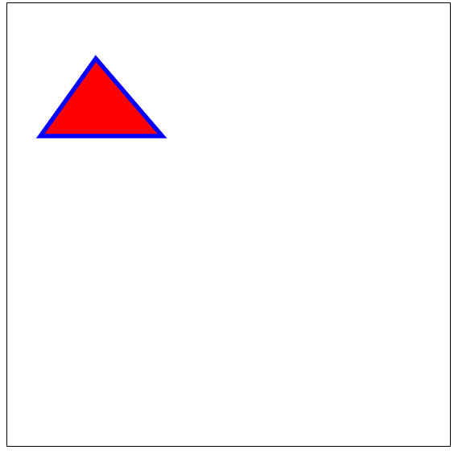
<!DOCTYPE html>
<html>
<body>
<svg width="400" height="400" style="border:1px solid black">
<polygon points="80,50 30,120 140,120" fill="red" stroke="blue" stroke-width="4" />
</svg>
</body>
</html>

Slide 19

<!DOCTYPE html>
<html>
<body>
<svg width="300" height="200">
<polygon points="100,10 30,198 190,78 10,78 160,198"
fill="lime" stroke="purple" stroke-width="5" fill-rule="evenodd" />
</svg>
</body>
</html>

Slide 20
Drag/Drop
Drag and Drop is a very interactive and user-friendly concept that makes it easier to move an object to a different location by grabbing it.
This allows the user to click and hold the mouse button over an element, drag it to another location, and release the mouse button to drop the element there.
In HTML 5 Drag and Drop are much easier to code and any element in it is draggable.

Slide 21
Drag & Drop Events
ondrag: It is used to use when the element or text selection is being dragged in HTML.
Ondragstart: It is used to call a function, drag(event), that specifies what data to be dragged.
ondragleave: It occurs when the mouse leaves an element before a valid drop target while the drag is occurring.
ondragover: It specifies where the dragged data can be dropped.
ondrop: It specifies where the drop has occurred at the end of the drag operation.
ondragend: It occurs when the user has finished dragging an element

Slide 22
Procedure
Step 1: Make an object draggable
First set the draggable attribute to true for that element to be draggable <img draggable = “true”>
Then, specify what should happen when the element is dragged. The ondragstart attribute calls a function, drag(event), that specifies what data to be dragged. The dataTransfer.setData() method sets the data type and the value of the dragged data
The event listener ondragstart will set the allowed effects (copy, move, link, or some combination).
Step 2: Dropping the Object
The ondragover event specifies where the dragged data can be dropped. By default, data/elements cannot be dropped in other elements. To allow a drop, it must prevent the default handling of the element. This is done by calling the event.preventDefault() method
Finally, the drop event, which allows the actual drop to be performed

Slide 23
<body>
<h3>Drag the LPU logo image into the rectangle:</h3>
<div id="getData"
ondrop="drop(event)"
ondragover="allowDrop(event)">
</div>
<img id="dragData"
src="lpu.png"
draggable="true"
ondragstart="drag(event)"
width="200"
height="100">
</body>
</html>
<!DOCTYPE HTML>
<html><head>
<style>
#getData {
width: 250px;
height: 200px;
padding: 10px;
border: 1px solid #4f4d4d;
}
</style>
<script>
function allowDrop(even) {
even.preventDefault();
}
function drag(even) {
even.dataTransfer.setData("text", even.target.id);
}
function drop(even) {
even.preventDefault();
var fetchData = even.dataTransfer.getData("text");
even.target.appendChild(document.getElementById(fetchData));}
</script></head>

Slide 24
Geolocation
The HTML Geolocation API is used to locate a user's position.
The HTML Geolocation API is used to get the geographical position of a user.
Since this can compromise privacy, the position is not available unless the user approves it.
The getCurrentPosition() method is used to return the user's position.

Slide 25
<html>
<body>
<p>Click the button to get your coordinates.</p>
<button onclick="getLocation()">Try It</button>
<p id="demo"></p>
<script>
var x = document.getElementById("demo");
function getLocation() {
if (navigator.geolocation) {
navigator.geolocation.getCurrentPosition(showPosition);
} else {
x.innerHTML = "Geolocation is not supported by this browser.";
}
}
function showPosition(position) {
x.innerHTML = "Latitude: " + position.coords.latitude +
"<br>Longitude: " + position.coords.longitude;
}
</script>
</body>
</html>
https://www.w3schools.com/html/tryit.asp?filename=tryhtml5_geolocation

Slide 26
The Navigator geolocation property is used to return a geolocation object by the browser which can be used to locate a user’s position.
innerHTML is used to get the internal HTML content of any HTML element as an HTML string.

Slide 27
Video
The HTML <video> element is used to show a video on a web page.
The controls attribute adds video controls, like play, pause, and volume.
It is a good idea to always include width and height attributes. If height and width are not set, the page might flicker while the video loads.
The <source> element allows you to specify alternative video files which the browser may choose from. The browser will use the first recognized format.
The text between the <video> and </video> tags will only be displayed in browsers that do not support the <video> element.

Slide 28
<video width="320" height="240" autoplay> <source src="movie.mp4" type="video/mp4"> <source src="movie.ogg" type="video/ogg"> Your browser does not support the video tag. </video>
Add muted after autoplay to let your video start playing automatically (but muted).
<video width="320" height="240" autoplay muted> <source src="movie.mp4" type="video/mp4"> <source src="movie.ogg" type="video/ogg"> Your browser does not support the video tag. </video>
There are three different formats that are commonly supported by web browsers – mp4, Ogg, and WebM.

Slide 29
Audio
The HTML <audio> element is used to play an audio file on a web page.
The controls attribute adds audio controls, like play, pause, and volume.
The <source> element allows you to specify alternative audio files which the browser may choose from. The browser will use the first recognized format.
The text between the <audio> and </audio> tags will only be displayed in browsers that do not support the <audio> element.

Slide 30
<audio controls autoplay> <source src="horse.ogg" type="audio/ogg"> <source src="horse.mp3" type="audio/mpeg"> Your browser does not support the audio element. </audio>
Add muted after autoplay to let your audio file start playing automatically (but muted).

Slide 31
Input Types
Sometimes, while filling the registration form or any online form, it would require to follow the proper format to fill the particular data. Now it’s easy to use the webform to fill up the common data like date, email, url etc. There are almost 13 new input types introduced in HTML5 form.
Syntax:-
<input type=“” />
In type Attribute we need to specify the input type we want to use in our form.

Slide 32
color: This input type allows the user to select a color from a color picker.
date: This input type allows the user to select a date from a drop-down calendar.
time: This input type allows the user to enter a time.
datetime: This input type allows the user to select date and time along with timezone.
Week: This input type allows the user to select week and year from the drop-down calendar.
email: This input type allows the user to enter an e-mail address.
month: This input type allows the user to select a month and year from a drop-down calendar.
number: This input type allows the user to enter a numerical value.
range: This input type allows the user to enter a numerical value within a specified range.
search: This input type allows the user to enter a search string within the input field.
tel: This input type allows the user to enter a telephone number.
url: This input type allows the user to enter the URL.
https://www.geeksforgeeks.org/explain-the-form-new-input-types-in-html5/

Slide 33
Form Elements
The HTML <form> element can contain one or more of the following form elements:
<input>
<label>
<select>
<textarea>
<button>
<fieldset>
<legend>
<datalist>
<output>
<option>
https://www.w3schools.com/html/html_form_elements.asp

Slide 34
Form Attributes
Action Attribute
The action attribute defines the action to be performed when the form is submitted.
Usually, the form data is sent to a file on the server when the user clicks on the submit button.
Syntax:
<form action="/action_page.php"> …. </form>

Slide 35
2. Target Attribute
The target attribute specifies where to display the response that is received after submitting the form.
The target attribute can have one of the following values:
Value | Description
_blank | The response is displayed in a new window or tab
_self | The response is displayed in the current window
_parent | The response is displayed in the parent frame
_top | The response is displayed in the full body of the window
The default value is _self which means that the response will open in the current window.
<form action="/action_page.php" target="_blank">

Slide 36
3. Method Attribute
The method attribute specifies the HTTP method to be used when submitting the form data.
The form-data can be sent as URL variables (with method="get") or as HTTP post transaction (with method="post").
The default HTTP method when submitting form data is GET.
<form action="/action_page.php" method="get">

Slide 37
Notes on GET:
Appends the form data to the URL, in name/value pairs
NEVER use GET to send sensitive data! (the submitted form data is visible in the URL!)
The length of a URL is limited (2048 characters)
Useful for form submissions where a user wants to bookmark the result
GET is good for non-secure data, like query strings in Google
Notes on POST:
Appends the form data inside the body of the HTTP request (the submitted form data is not shown in the URL)
POST has no size limitations, and can be used to send large amounts of data.
Q. Difference between Get And Post Method? (imp.)

Slide 38
4. Autocomplete Attribute
The autocomplete attribute specifies whether a form should have autocomplete on or off.
When autocomplete is on, the browser automatically complete values based on values that the user has entered before.
<form action="/action_page.php" autocomplete="on">

Slide 39
Semantic Elements
A semantic element clearly describes its meaning to both the browser and the developer.
Semantic elements have meaningful names which tell about the type of content.
For example header, footer, table, … etc. HTML5 introduces many semantic elements as mentioned below which make the code easier to write and understand for the developer as well as instruct the browser on how to treat them.
<article> , <aside>, <details>, <figcaption>, <figure>, <footer>, <header>, <main>, <mark>, <nav>, <section>, <summary>
All these are Semantic Elements which means element with meaning.
https://www.w3schools.com/html/html5_semantic_elements.asp

Slide 40
Web Storage
With web storage, web applications can store data locally within the user's browser.
Before HTML5, application data had to be stored in cookies, included in every server request. Web storage is more secure, and large amounts of data can be stored locally, without affecting website performance.

Slide 41
Web Storage Objects
HTML web storage provides two objects for storing data on the client:
window.localStorage - stores data with no expiration date
window.sessionStorage - stores data for one session (data is lost when the browser tab is closed).
Before using web storage, check browser support for localStorage and sessionStorage:
if (typeof(Storage) !== "undefined") { // Code for localStorage/sessionStorage. } else { // Sorry! No Web Storage support.. }
https://www.w3schools.com/html/html5_webstorage.asp

Slide 42
Types of Web Storage
There are two types of web storage with different scope and lifetime.
Local Storage: Local Storages uses Windows.localStorage object which stores data and available for every page. But data persist even if the browser is closed and reopened (Stores data with no Expiration).
Session Storage: Session Storage uses Windows.sessionStorage object which stores data for one session and data will be lost if the window or browser tab will be closed.

Slide 43
<!DOCTYPE HTML>
<html>
<body>
<script type = "text/javascript">
if( localStorage.hits ) {
localStorage.hits = Number(localStorage.hits) +1;
} else {
localStorage.hits = 1;
}
document.write("Total Hits :" + localStorage.hits );
</script>
<p>Refresh the page to increase number of hits.</p>
<p>Close the window and open it again and check the result.</p>
</body>
</html>

Slide 44
Session Storage
<!DOCTYPE HTML>
<html>
<body>
<script type = "text/javascript">
if( sessionStorage.hits ) {
sessionStorage.hits = Number(sessionStorage.hits) +1;
} else {
sessionStorage.hits = 1;
}
document.write("Total Hits :" + sessionStorage.hits );
</script>
<p>Refresh the page to increase number of hits.</p>
<p>Close the window and open it again and check the result.</p>
</body>
</html>

Slide 45
Remove Web Storage
localStorage.clear(): If you want to delete or clear all settings with key/value pair, then you can call this method.

Slide 46
App Cache
HTML5 introduces application cache, which means that a web application is cached, and accessible without an internet connection.
Application cache gives an application three advantages:
Offline browsing - users can use the application when they're offline.
Speed - cached resources load faster.
Reduced server load - the browser will only download updated/changed resources from the server.

Slide 47
<!DOCTYPE html>
<html manifest="example.appcache">
<head> <!-- Other head elements -->
</head>
<body> <!-- Your web application content -->
</body>
</html </body> </html>
CACHE MANIFEST
# Version 1.0
index.html
styles.css
script.js
image.pngANIFEST # Version 1.0 index.html styles.css script.js image.png

Slide 48
Web Worker
When executing scripts in an HTML page, the page becomes unresponsive until the script is finished.
A web worker is a JavaScript that runs in the background, independently of other scripts, without affecting the performance of the page. You can continue to do whatever you want: clicking, selecting things, etc., while the web worker runs in the background.
https://www.w3schools.com/html/tryit.asp?filename=tryhtml5_webworker

Slide 49
SSE
A server-sent event is when a web page automatically gets updates from a server.
This was also possible before, but the web page would have to ask if any updates were available. With server-sent events, the updates come automatically.
Examples: Facebook/Twitter updates, stock price updates, news feeds, sport results, etc.

Slide 50
<!DOCTYPE html>
<html>
<body>
<h1>Getting server updates</h1>
<div id="result"></div>
<script>
if(typeof(EventSource) !== "undefined") {
var source = new EventSource("demo_sse.php");
source.onmessage = function(event) {
document.getElementById("result").innerHTML += event.data + "<br>";
};
} else {
document.getElementById("result").innerHTML = "Sorry, your browser does not support server-sent events...";
}
</script>
</body>
</html>

